Slide 1

Heart Disease Diagnostic Analysis
DONE BY:
P L NANCY

Slide 2

Agenda
PROBLEM STATEMENT
KEY METRICS & ATTRIBUTES
INSIGHTS
VISUALS FOR KEY METRICS & ATTRIBUTES
CONCLUSION

Slide 3

Problem STATEMENT
Health is real wealth in the pandemic time we all realized the brute effects of covid-19 on all irrespective of any status. You are required to analyze this health and medical data for better future preparation. Do ETL: Extract, Transform and Load data from the heart disease diagnostic database You can perform EDA through python. The database extracts various information such as Heart disease rates, Heart disease by gender, by age. You can even compare attributes of the data set to extract necessary information. Make the necessary dashboard with the best you can extract from the data. Use various visualization and features and make the best dashboard Find key metrics and factors and show the meaningful relationships between attributes.

Slide 4

KEY METRICS & ATTRIBUTES
Age Distribution Analysis :
Resting Blood Pressure
Cholesterol
Coronary Arteries
Diagnosis Results
Gender Distribution Analysis :
Exercise Induced Angina
Thallium Stress Test Results
Diagnosis Result
Chest Pain Analysis :
Age
Heart Rate
Gender
Diagnosis Results
Slope Analysis by Heart Rate and Diagnosis Results
Resting ECG Result Analysis by Heart Rate and Diagnosis Results
ST depression Analysis :
Age with Results
Resting Blood Pressure
Exercise Induced Angina

Slide 5


INSIGHTS
1. Blood pressure tends to exceed the normal range across all age groups, peaking in individuals aged 40-59 and 60-70.
2. Most patients have cholesterol levels above 200 mg/dL, falling into borderline high or very high categories.
3. Age groups between 38 to 77 commonly exhibit coronary artery blockages, with prevalence increasing with the number of affected arteries.
4. Mid-age adults (40-59 years) have a higher incidence of heart disease compared to other age groups.
5. Males show a higher frequency of Exercise Induced Angina than females.
6. In male Thallium Stress Test results, reversible defects are more common than fixed defects, with males having a better ratio of normal results compared to females.
7. Males have a higher likelihood of heart disease than females.
8. Different age ranges have distinct types of chest pain, with typical angina more prevalent in older age groups.
9. Higher heart rates correlate with a higher likelihood of experiencing chest pain, particularly atypical angina.
.

Slide 6
INSIGHTS
10. Males exhibit a higher incidence of asymptomatic chest pain, atypical angina, and non-anginal pain compared to females.
11. Non-anginal pain is the most common type of chest pain, followed by atypical angina and typical angina, with asymptomatic cases being less frequent.
12. The slope on an ECG indicates the likelihood of heart disease, with a higher heart rate corresponding to a steeper slope, suggesting increased risk.
13. Patients with high heart rates often exhibit borderline ECG results, indicating a heightened risk of heart disease compared to those with normal results.
14. ST depression is most pronounced in individuals aged above 35-40 years, with spikes observed around ages 55 and 70.
15. Increased blood pressure correlates with ST depression, potentially indicating a link between hypertension and cardiac ischemia.
16. Individuals with exercise-induced angina show greater variability in ST depression levels, indicating varying degrees of myocardial ischemia.

Slide 7
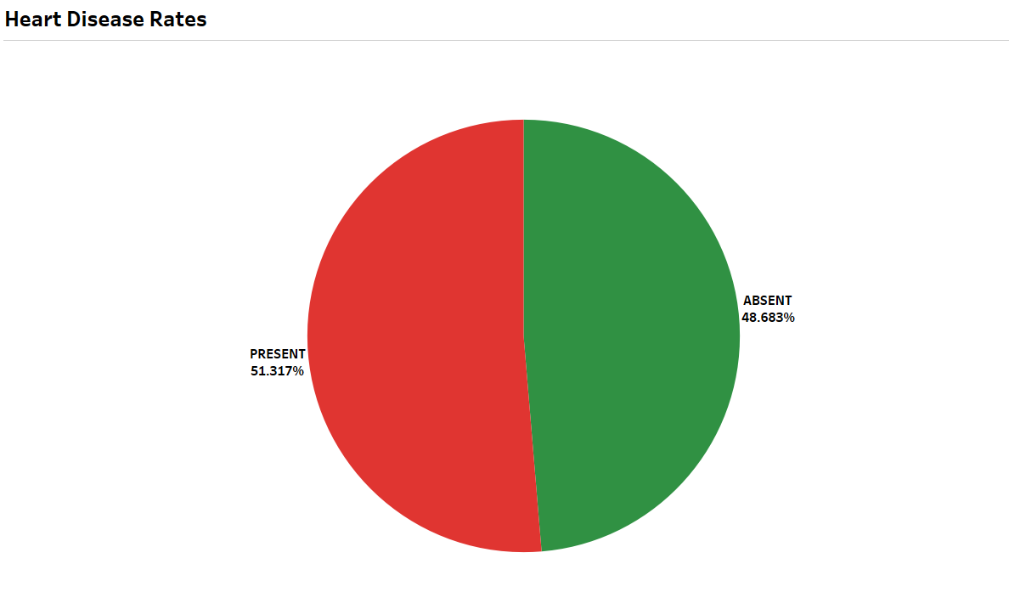
VISUALS FOR Heart Disease Rates

Slide 8
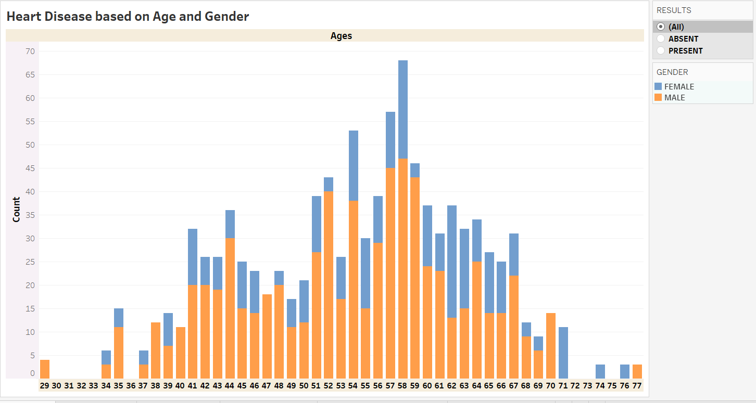
VISUALS FOR Heart Disease based on Age and Gender

Slide 9
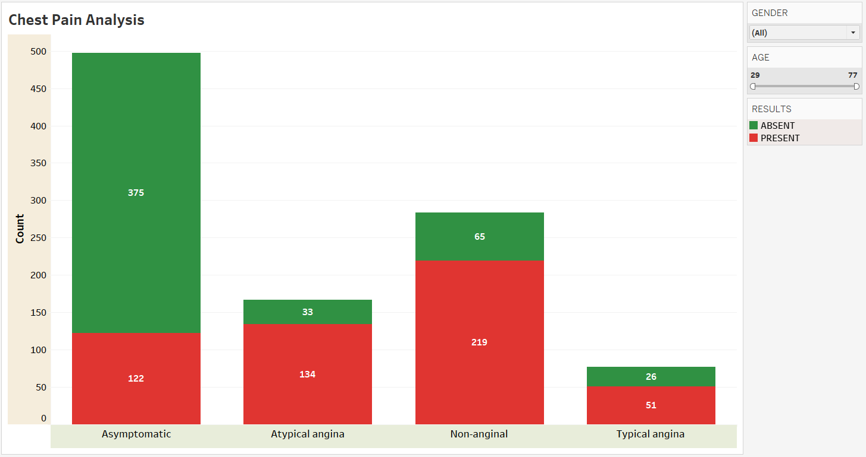
VISUALS FOR Chest Pain Analysis

Slide 10
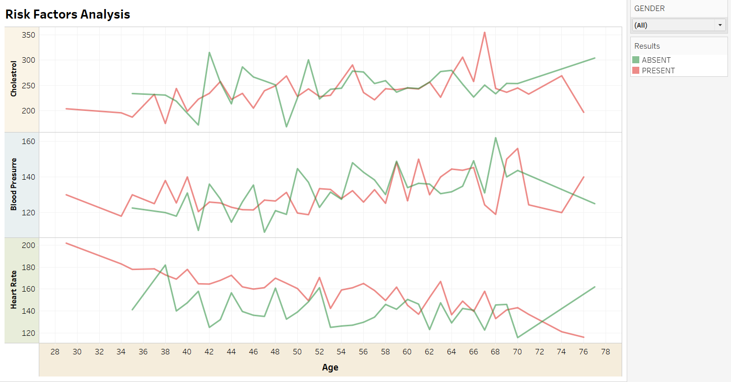
VISUALS FOR Risk Factor Analysis

Slide 11
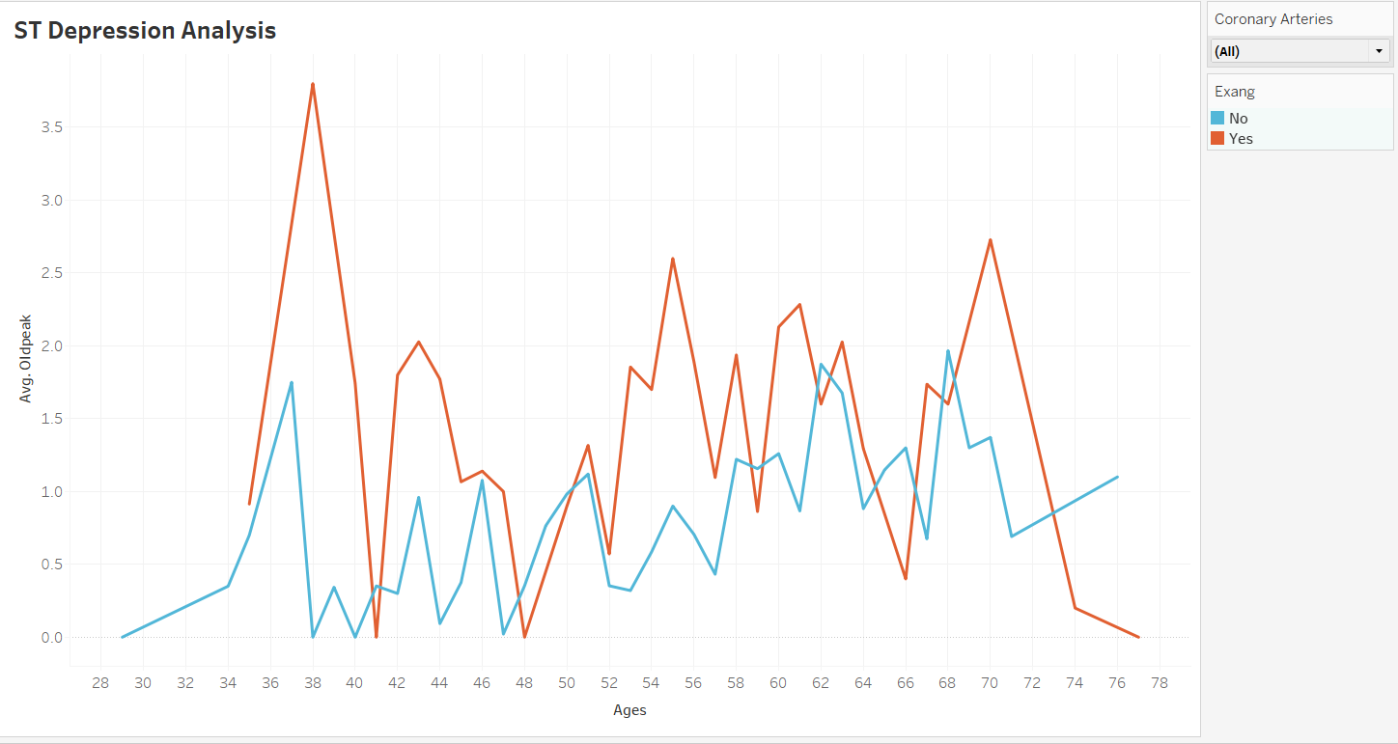
VISUALS FOR ST Depression Analysis

Slide 12
CONCLUSION
Monitor blood pressure and cholesterol levels regularly, and consult a doctor if they are high.
Maintain a healthy lifestyle with regular exercise and a balanced diet to lower the risk of heart disease.
If experiencing chest pain, especially during exercise, seek medical attention promptly for proper evaluation and treatment.

Slide 13


Thank you

